Slide 1

Blinkit
India’s last Minute App
Tharigonda Reddy Lakshmi

Slide 2


Blinkit Performance Dashboard (Power BI)
This project showcases an interactive Power BI dashboard built to analyze blinkit’s business performance data.
It is designed to provide actionable insights into sales, customer behavior, product performance, and regional metrics.

Slide 3

introduction
Blinkit is a premier Indian quick-commerce company that delivers groceries, electronics, and daily essentials to doorsteps in 10-20 minutes. Founded in 2013 (originally as Grofers ) and acquired by Zomato in 2022, it operates hundreds of localized "dark stores" across India to ensure lightning-fast fulfillment.

Slide 4
Tools & Technologies Used
Power BI: For building interactive dashboards and reports
DAX (Data Analysis Expressions): For calculating KPIs and advanced metrics
Excel / CSV Files: As the primary data source

Slide 5
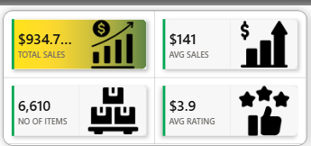
Executive Summary
Total Sales: $934.7K achieved across all operating segments.
Total sales = SUM('BlinkIT Grocery Data'[Sales])
Average Sales Value: $141 per transaction.
Avg sales = AVERAGE('BlinkIT Grocery Data'[Sales])
Total Inventory: 6,610 distinct items managed in the system.
No Of Items = COUNTROWS( 'BlinkIT Grocery Data’)
Customer Satisfaction: Strong average rating of 3.9 out of 5 stars.
Avg Rating = AVERAGE('BlinkIT Grocery Data'[Rating])
💡 Visual Components Used:
Card Visuals (KPI Blocks): Used to isolate and highlight single, critical numbers. This instantly gives executives the bottom-line health of the business without clutter.

Slide 6
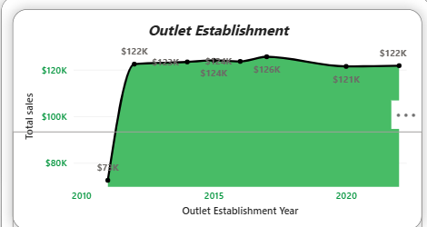
Outlet Establishment & Sales Evolution
Historical Growth: Retail footprint and sales saw a sharp upward trajectory between 2010 and 2015.
Peak Performance: Total sales peaked in 2015, crossing the $126K threshold.
Current Status: Stabilization observed through 2020, leveling off near $121K–$122K.
💡 Visual Components Used:
Line Chart (Sales vs. Year): Used to show continuous data over time. The filled area beneath the line emphasizes the massive scale of growth achieved between 2010 and 2022.

Slide 7
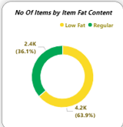
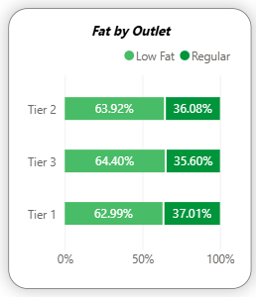
Inventory & Fat Content Breakdown
Inventory Domination: Regular fat items make up the majority of the catalog at 63.9% (4.2K items).
Healthy Alternatives: Low-fat items comprise 36.1% of stock (2.4K items).
Tier Distribution: Tier 2 outlets hold the highest overall inventory of both low-fat and regular items.
💡 Visual Components Used:
  Donut Chart (Fat Content): Used to display part-to-whole relationships. It is restricted to just two categories (Low vs. Regular), making it highly readable.
  100% Stacked Bar Chart (Fat by Outlet): Used to compare sub-categories across locations. It allows the viewer to see total inventory per tier while simultaneously seeing the fat content ratio.

Slide 8
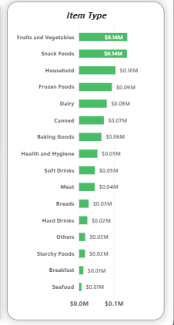
Inventory Volume by Item Type
Top Contributors: Fruits/Vegetables (958 items) and Snack Foods (930 items) lead inventory volume.
Mid-Tier Categories: Household items (699), Frozen Foods (680), and Dairy products (530).
Niche Segments: Seafood (46 items) and Breakfast foods (85 items) represent the smallest operational footprint.
💡 Visual Components Used:
Stacked Bar Chart: Used because there are over 15 distinct product categories. Vertical bars would crowd the text, whereas horizontal bars provide clean text alignment on the left for easy scanning.

Slide 9
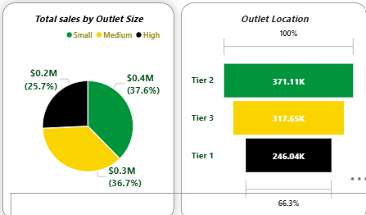
Sales Contribution by Size and Location
Outlet Size Impact: small-sized outlets drive the largest revenue chunk at 37.6% ($0.4M), followed closely by medium-sized outlets at 36.7% ($0.3M). large outlets represent 25.7% ($0.2M).
Geographic Demographics: Tier 2 regions generate the highest localized traction (371.11K), outperforming Tier 3 (317.65K) and Tier 1 markets (246.04K).
💡 Visual Components Used:
  Pie Chart (Sales by Outlet Size): Used to easily compare the market share distribution between Small, Medium, and High formats.
  Funnel Chart (Outlet Location): Used to visually rank the tiers from highest performing to lowest. The tapering effect highlights the drop-off in sales volume between regions.

Slide 10
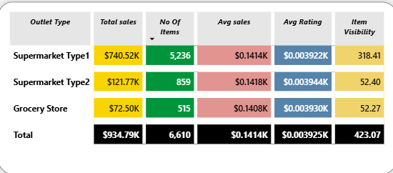
Performance Matrix by Store Format
Supermarket Type 1: The primary revenue engine, generating $740.52K in sales with 5,236 items.
Supermarket Type 2: Mid-tier performance tracking at $121.77K in sales across 859 items.
Grocery Stores: Smallest scale footprint with $72.50K in total revenue and 515 items managed.
Efficiency Note: Average sales metrics remain remarkably consistent ($0.14K) across all three formats.
💡 Visual Components Used:
Matrix/Data Table (with Heatmap Conditional Formatting): Used to display dense, multi-variable granular data. The subtle red and blue background shading (heat-mapping) guides the eye immediately to outliers, such as the massive sales spike in Supermarket Type 1.

Slide 11
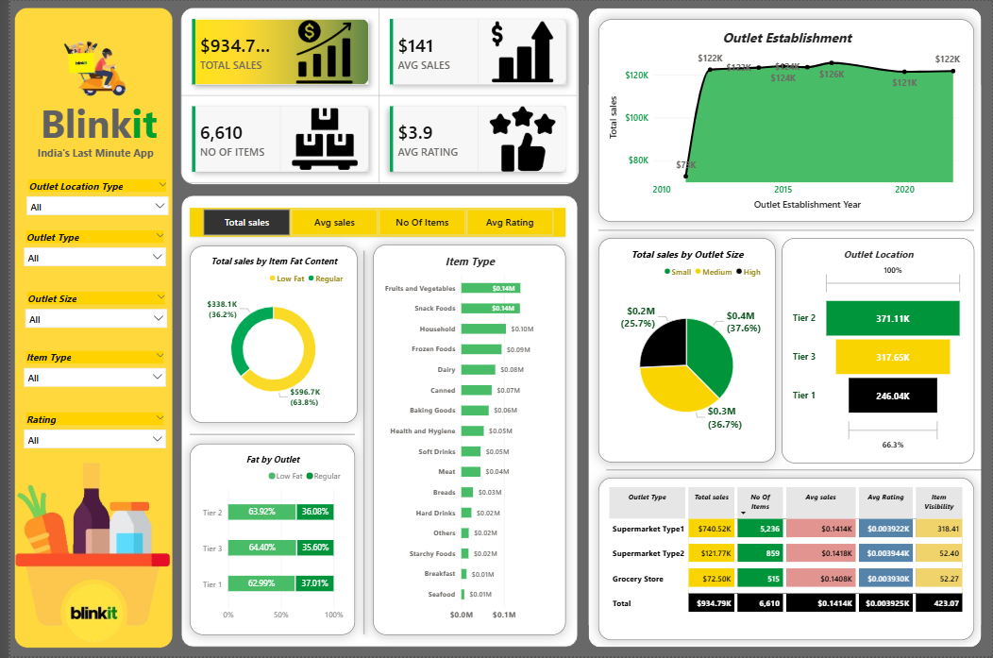

Slide 12
Conclusion
Core Drivers: Blinkit’s revenue is successfully powered by Supermarket Type 1 formats and high-performing Tier 2 regional markets.
Growth Path: Future success relies on scaling small outlet formats and optimizing inventory to match high-demand food categories.

Slide 13
Thank You

